Slide 1


Angular
Aruna S
Department of
Computer Science and Engineering

Slide 2

angular
Angular Components
S. Aruna
Department of Computer Science and Engineering

Slide 3
Angular
Components
Component Lifecycle

Slide 4
Angular
Components - Lifecycle
A component instance has a lifecycle that starts when Angular instantiates the component class and renders the component view along with its child views.
The lifecycle continues with change detection, as Angular checks to see when data-bound properties change, and updates both the view and the component instance as needed.
The lifecycle ends when Angular destroys the component instance and removes its rendered template from the DOM
Angular provides eight interfaces to implement those as component goes from creation to destruction phases.

Slide 5
Angular
Components – Life Cycle
ngOnInit(): This is called when the component is loaded into the DOM and it occurs only once.
ngOnChanges(): This is called when there is Input property to the component and it is called before ngOnInit() and occurs every time there is a change in the input property. It is not called if there is no input property to the component
ngDoCheck(): occurs every time there is a change detection and immediately after ngOnChanges() and ngOnInit().
ngOnDestroy(): This is called right before the component gets destroyed and occurs only once.

Slide 6
Angular
Components - Lifecycle
ngAfterViewInit(): This is called once after the component’s view/ child views are loaded and right after ngAfterContentChecked() and occurs only once.
ngAfterViewChecked(): This is called after component’s view/ child views are loaded and called after ngAfterViewInit() and every time after ngDoCheck().
ngAfterContentInit(): This is called once external content is projected into component’s view and right after the first ngDoCheck() and occurs only once.
ngAfterContentChecked(): This is called after external content projected into component’s view and called after ngAfterContentInit() and every subsequent ngDoCheck().

Slide 7
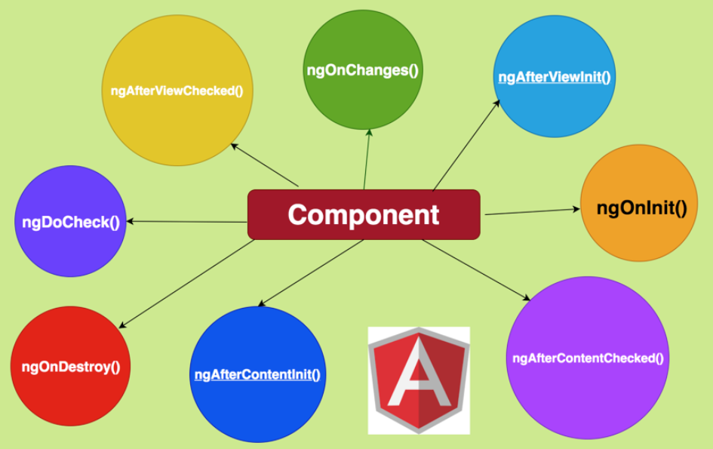
Angular
Component - Lifecycle Hooks

Slide 8
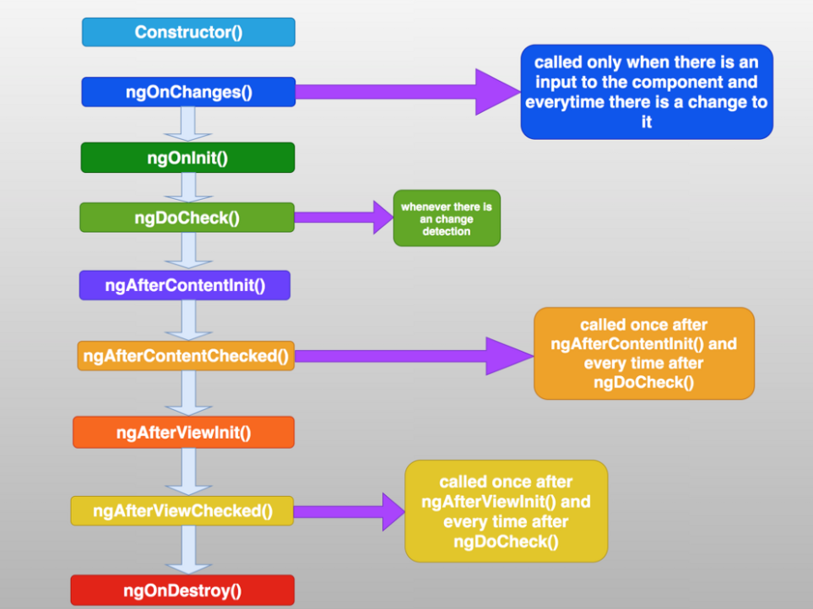
Angular
Component - Angular Lifecycle Hooks Order

Slide 9
THANK YOU
Aruna S
Department of
Computer Science and Engineering
arunas@pes.edu

